Slide 1
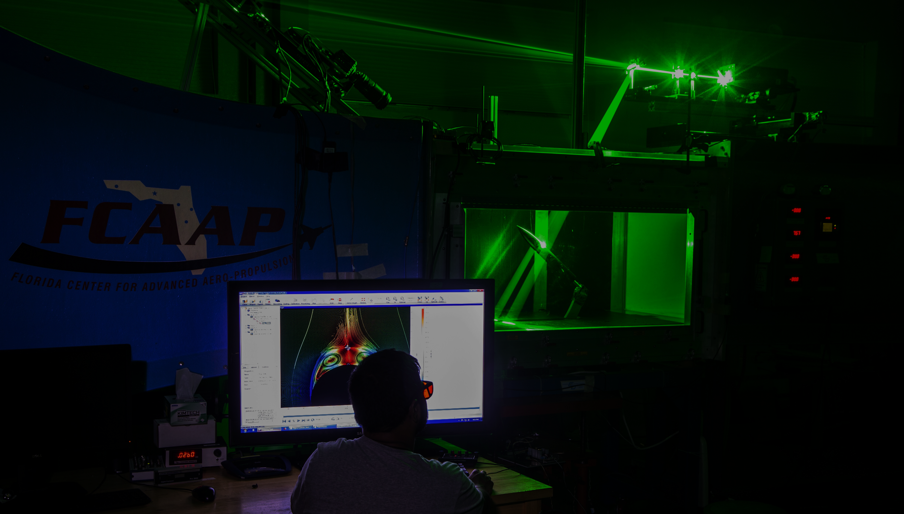
Smart Projectile
Jack Corbin | Prosley Dorcely | Emily Groth
Deepkumar Patel | Aaron Weingarten

Slide 2
Team 509
Jack Corbin
Fin Engineer
Prosley Dorcely
Hardware Engineer
Emily Groth
Assembly Engineer
Deepkumar Patel
Design Engineer
Aaron Weingarten
Systems Engineer

Slide 3
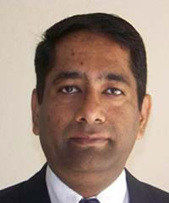
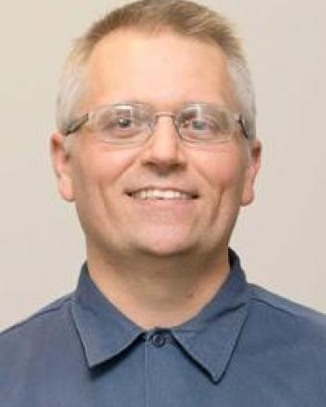
Sponsor and Advisor
Dr. Rajan Kumar
Sponsor
Dr. Jonas Gustavsson
Advisor
Robert Smith
Advisor

Slide 4
Objective
The objective of the project is to create a scale model of a projectile with an articulating nose cone and deflectable fins for subsonic wind tunnel testing.

Slide 5
Markets and Stakeholders
FCAAP
Air Force
Boeing
Raytheon
Lockheed Martin
General Dynamics
College of Engineering
Dr. Jonas Gustavsson
Dr. Rajan Kumar
Dr. Shayne McConomy
Dr. Suvranu De
Presenter's Name

Slide 6
Updated Customer Needs
L/D ration of 8, 12,16
Diameter of 2 inches
Nose deflection between 0 to 5 degrees with resolution ±0.1
Static or dynamic deflectable fins
Time constant optimized to less than 0.5 seconds
Suitable material and design for subsonic testing
Aaron Weingarten

Slide 7
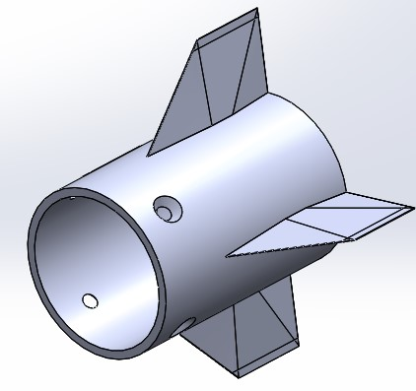
Fin Deflection
Our idea is to implement four small motors to control each individual fin
Only issue is the space in the rear portion of the model
Need to find motors that are small enough to fit in body and have high precision
Aaron Weingarten

Slide 8
Motor Selection
Requirements:
5 grams or less
Under 0.65 in Diameter
Available:
Servo - Hitec HS-35HD (Ultra Nano Size)
FEETECH Sub-Micro Servo FS0307
Sub-Micro Servo 3.7g
FEETECH Sub-Micro Servo FS0403-FB
Characteristics:
Aaron Weingarten

Slide 9
Fin Motor Configuration 1
Right Side View
Back View
Aaron Weingarten

Slide 10
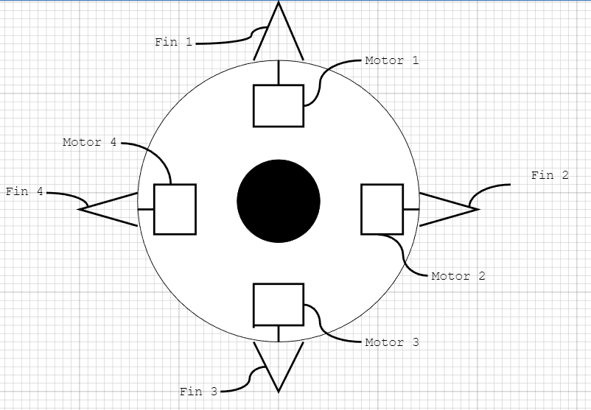
Fin Motor Configuration 2
Right Side View
Back View
Aaron Weingarten

Slide 11
Fin Attachment
Method 1
Weld a large short shaft to end of fin
Brittle connection
Possible manufacturing problem when cleaning up connection surface
Method 2
Drill hole in each fin and insert a smaller shaft inside
Might be weaker and compromise the fin
Shaft would fail from bending
Aaron Weingarten

Slide 12
Nose Cone Deflection
Re-designing deflection mechanism for 5 degrees instead of 20 degrees
Presenter's Name

Slide 13
Nose Cone Lightweighting

Slide 14
Parts that Need to be Machined Again
Back fin body
Frontal Motor Mount
Frontal Deflecting Surface
Rear Deflecting Surface
Mounting Hub

Slide 15
Next Steps
Create CAD for fin deflection design
Assembly of the projectile
Redesigning the nose cone
Purchase or re-machine parts that cannot be salvaged
Implement controls
Presenter's Name

Slide 16
Future Work
Prosley Dorcely

Slide 17
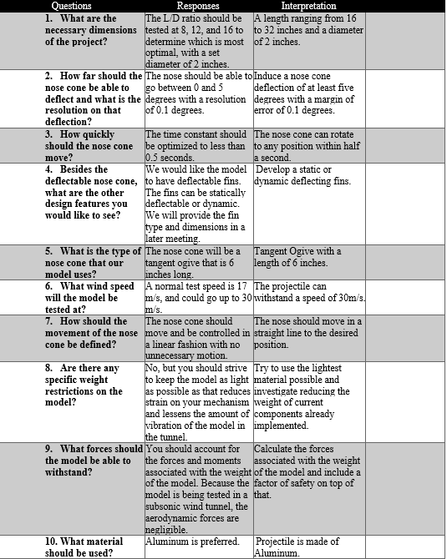
Customer Needs Backup

Slide 18
Markets Backup
Primary Market
FCAAP (Florida Center for Advanced Aero Propulsion)
Secondary Markets
Air Force Office of Scientific Research (AFOSR)
Air Force Research Laboratory (AFRL)
Lockheed Martin
General Dynamics
Raytheon Technologies
Boeing
Northrop Grumman

Slide 19
Stakeholders Backup
Florida Center for Advanced Aero Propulsion
FAMU-FSU College of Engineering
Dr. Rajan Kumar
Dr. Jonas Gustavsson
Dr. Shayne McConomy
Dr. Suvranu De

Slide 20
Standard Shapes
Summary Box
Text box 1
Outlined Text Box

Slide 21
Approved Logos

Slide 22
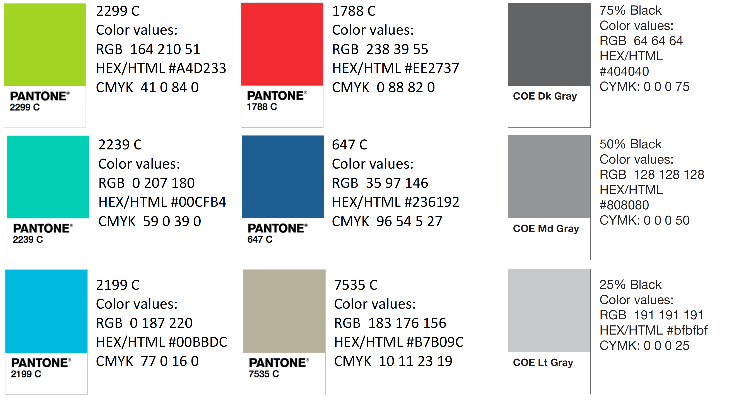
Color Palette

Slide 23
APA Tables
Category 1 | Category 2 | Category 3 | Category 4 | Category 5
Item 1
Item 2
Item 3
Item 4
 | Category 2 |  |  | Category 3
Category 1 | subcategory 1 | subcategory 2 |  | subcategory 1 | subcategory 2
Item 1
Item 2
Item 3
Item 4

